Slide 1
CLL Chemo- Free Treatment
e
Dr. Seham Sulaiman, MD
Professor of Medicine
Damascus University- Syrian Private University

Slide 2
Diagnosis of CLL
Presenter Notes
2023-08-15 08:04:45
--------------------------------------------
Recently the guidelines established by the National Cancer Institute-Working Group (NCI-WG) have been revised. For the definitive diagnosis of CLL to be made, a patient must have1:
Absolute lymphocytosis with a minimum threshold of ³5000 small, mature-appearing lymphocytes/µL, showing clear evidence of monoclonal expansion of B cells characteristic of CLL No more than 55% atypical or immature lymphoid cells in peripheral blood. In practice, these cells rarely exceed 15% to 20%
Infiltration of the bone marrow by lymphocytes (³30%)
CLL may be diagnosed whenever there is an absolute increase in lymphocytes in blood and their morphology and immunophenotype exhibit the characteristic features of the disease. A careful review of a peripheral blood smear is essential to make the diagnosis.2
Features diagnostic of CLL are B lymphocytes with a low density of surface immunoglobulin (sIg), including either k or l light chains, but not both; B-cell–specific surface antigens, such as CD19, CD20, and CD23; and the CD5 surface antigen in the absence of other T-cell markers.2 Although there are atypical cases of CLL, other lymphoproliferative disorders should be carefully considered before atypical CLL is diagnosed. In this regard, analysis of the immunophenotype of the neoplastic B cells may be useful.2
1. Cheson et al. Blood. 1996;87:4990-4997.
2. Rozman et al. N Engl J Med. 1995;333:1052-1057.
Lymphocytosis (small, mature lymphocytes
≥5000/µL)
Bone marrow involvement of ≥30% lymphocytes
≤55% atypical/immature lymphoid cells in peripheral blood
Clonal expansion of abnormal B lymphocytes
B-cell surface antigens (CD19, CD20, CD23);
CD20 dim
CD5 surface antigen

Slide 3
Immunophenotypic Differentiation of B-CLL From Other Chronic Lymphoproliferative Disorders
Presenter Notes
2023-08-15 08:04:45
--------------------------------------------
In this table, + indicates that the antigen or marker is commonly expressed, - indicates that it is generally not expressed, and V indicates that it is variably expressed.
Cellular morphology, cytochemistry, and bone marrow biopsy are extremely useful in making the correct diagnosis of CLL.1,2 In many instances, however, immunophenotypic analyses act as a final determinant necessary for a precise, initial diagnosis of CLL.
Both the nature and degree of expression of specific markers on the surface of malignant cells can be used in differential diagnosis. On the basis of such analyses, it is now clear that CLL is derived almost exclusively from cells of the B lineage.1-5 T-cell chronic lymphocytic leukemia (T-CLL) is a rare entity with its own characteristic features.6 As with other B-cell malignancies, B-CLL cells express surface membrane (Sm) Ig. In contrast to other B-CLL malignancies, the expression of Ig on CLL cells is weak
CD19 and CD20 are B-cell antigens. However, CD19 is usually heavily expressed in B-CLL, whereas CD20 expression is light
B-CLL cells also express CD5, a pan–T-cell antigen. Mantle cell lymphoma (MCL) in leukemic phase is often confused with CLL because both are CD5+. However, MCL differs from CLL in several aspects including the intensity of CD20 expression, amount of sIg, lack of CD23, lack of CD11c and positivity for FMC7. Occasionally, in specific cases of PLL evolved from CLL, cells express CD5, but those cells have morphologic features distinctly different from CLL cells. The availability of multiparameter flow cytometry facilitates these analyses
Although there are atypical cases of CLL, other lymphoproliferative disorders should be carefully considered before atypical CLL is diagnosed. In this regard, analysis of the immunophenotype of the neoplastic B cells may be useful. For example, PLL is a separate entity and should not be regarded as a variant of CLL. PLL is characterized by the typical phenotype: SmIg++, CD19+, CD20+, CD23-/+, and FMC7+. B-PLL is also positive for CD79b and CD22, 2 markers that CLL usually does not express. This contrasts with CLL–PLL, whose clinical features and immunophenotype are much closer to those of CLL. [Dr. O’Brien, Zomas et al reported CD79b in 5% of CLL (we graded as -); 92% of MCL (we graded as +); 74% of SLVL (we graded
as V); and 100% of PLL (we graded as +). Do you concur?]
1. Cheson et al. Blood. 1996;87:4990-4997. 4. Batata et al. Cancer. 1992;70:2436-2443. 2. Kroft et al. Blood Rev. 1995;9:234-250. 5. Zomas et al. Leukemia. 1996;10:1966-1970. 3. O’Brien et al. Blood. 1995;85:307-318. 6. Hoyer et al. Blood. 1995;86:1163-1169.
Antigen/Marker | CLL | MCL | SLVL | B-PLL
slg intensity | Weak | Strong | Strong | Strong
CD19/CD20 | + | + | + | +
CD5 | + | + | V | -
CD23 | + | - | V | V
CD11c | V | - | V | -
FMC7 | V | + | + | +
CD79b | - | + | V | +
CD22 | - | V | + | -

Slide 4
Genomic Aberrations In CLL Interphase FISH Results 82% Abnormal
Abnormality No. Patients (%)
13q deletion | 178 | (55)
11q deletion | 58 | (18)
trisomy 12 | 53 | (16)
17p deletion | 23 | (7)
6q deletion Dohner et al. N Engl J Med. 2000; 343:1910-1916. | 21 | (6)

Slide 5

Probability of Survival
100
17p deletion 11q deletion
80
12q trisomy Normal
13q deletion as sole abnormality
Patients Surviving (%)
60
40
20
0
0 12 24 36 48 60 72 84 96 108 120 132 144 156 168 180
Months
Dohner et al. N Engl J Med. 2000;343:1910-1916.

Slide 6
Ig V Gene Mutations and CD38: Newer Prognostic Factors in CLL
Presenter Notes
2023-08-15 08:04:46
--------------------------------------------
B-cell chronic lymphocytic leukemia (B-CLL) cells are CD5+. Originally, investigators presumed that this meant that these cells had not been exposed to antigens. However, by identifying significant numbers of somatic mutations in the Ig heavy-chain variable (V) region, it has become clear that in at least half of cases, the malignant clone expanded in B-CLL derives from previously triggered, postgerminal center “memory” B cells. Whether CLL derives from “virgin” lymphocytes or “memory” B cells appears to have prognostic significance. Damle and colleagues categorized 47 patients on the basis of whether mutations were present in the variable regions. The Kaplan-Meier curve on the left indicates the prognostic significance of mutated, as compared to unmutated, variable regions. Median survival was 9 years for patients without variable gene mutations, but median survival for patients with variable gene mutations had not been reached (P=.0001).
A smaller percentage of CD38-expressing cells is associated with a more favorable prognosis as well. The Kaplan-Meier curve on the right shows survival times for 36 patients with CD38 expression on <30% of B-CLL cells as compared to patients with 30% of B-CLL cells expressing CD38. Median survival of patients with 30% of CD38 expression was 10 years, but median survival had not been reached for patients with B-CLL cells expressing less CD38 (P=.001). Damle et al. Blood. 1999;94:1840-1847.
Ig V CD38
100
90
80
70
60
50
40
30
20
10
0
100
90
80
70
60
50
40
30
20
10
0
Percent Surviving
Unmutated
≥30%
Mutated
<30%
0 2 4 6 8 101214161820
0 2 4 6 8 101214161820
Years From Diagnosis
Damle et al. Blood. 1999;94;1840-1847.

Slide 7
Prognostic Value of ZAP-70 in Patients With Stage A Binet CLL: Survival
Presenter Notes
2023-08-15 08:04:47
--------------------------------------------
Kaplan-Meier estimates of the likelihood of survival among patients with Binet stage A CLL, according to the level of expression of ZAP-70. The probability of survival at 10 years was 90% among patients with <20% of ZAP-70–expressing cells. The median survival was 90 months among those with 20% of ZAP-70–expressing cells, whereas it was not reached among patients with <20% of ZAP-70–expressing cells (P=0.01). Tick marks indicate censored data. Crespo et al. N Engl J Med. 2003;348:1764.
100
90
80
70
60
50
40
30
20
10
0
<20% ZAP-70–positive cells
Probability of survival (%)
(N=44)
(P=0.01)
≥20% ZAP-70–positive cells
8 12 16 20 24 28 32
Years after diagnosis
0
36
4
Crespo et al. N Engl J Med. 2003;348:1764.

Slide 8
Prognostic Factors in CLL
Parameter Bad
B₂M FISH
VH Mutation Status CD38
ZAP70
increased 11q-, 17p-
unmutated positive positive

Slide 9
IWCLL-NCI: Indications to Initiate Treatment for CLL
Presenter Notes
2023-08-15 08:04:47
--------------------------------------------
When to begin therapy remains one of the most challenging issues confronting physicians who care for patients with CLL. Outside of clinical trials, the therapeutic goal for most CLL patients who require treatment has been palliation of symptoms. The guidelines suggested for initiation of therapy from the NCI consensus panel on CLL are summarized on this slide.
The decision on initiation of therapy must be individualized to the patient’s clinical status and comorbid conditions. Although constitutional symptoms alone may be an indicator for therapy, a search for other etiologies for weight loss or fever is important. Cytopenia may be caused by autoantibodies in addition to marrow impairment. Cheson et al. Blood. 1996;87:4990-4997.
Constitutional symptoms referable to CLL
Progressive marrow failure
Autoimmune anemia +/- thrombocytopenia poorly responsive to steroids or other
Massive (>6 cm) or progressive splenomegaly
Massive (>10 cm) or progressive lymphadenopathy
Symptomatic extranodal involvement (eg. skin, kidney, lung, spine)
Progressive lymphocytosis, >50% increase over 2 months or LDT < 6 months.
Hallek et al. Blood. 2018 June 21;131(25);2745-2760.

Slide 10
Why Not Treat CLL at Diagnosis
Indolent disease
Patients often asymptomatic
Median age early 70’s
No cure

Slide 11
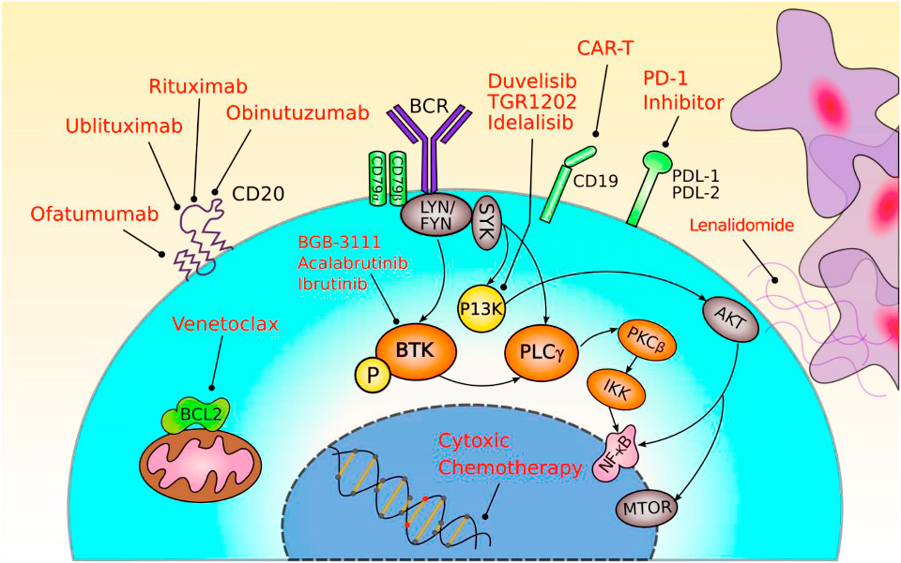

Slide 12


RESONATE-2: Phase 3 Trial in 1L CLL/SLL
Presenter Notes
2023-08-15 08:04:54
--------------------------------------------
Speaker Notes:
In the RES-2 trial, a total of 269 eligible participants were randomized in a 1:1 ratio to treatment with ibrutinib 420mg PO QD or chlorambucil The primary endpoint was progression free survival (PFS) by independent review committee (IRC)
The key endpoints included overall survival, overall response, safety, and the rate of sustained improvements in hematologic variables (Hgb, and platelets) References:
1. Burger JA, Barr PM, Robak T, et al. Long-term efficacy and safety of first-line ibrutinib treatment for patients with CLL/SLL: 5 years of follow-up from the phase 3 RESONATE-2 study. Leukemia. 2020;34(3):787-798. 2. Clinicaltrials.gov. Open-label phase 3 btk inhibitor ibrutinib vs chlorambucil patients 65 years or older with treatment-naive cll or sll. https://clinicaltrials.gov/ct2/show/NCT01722487. Accessed May 2, 2022
Phase 3 randomized, multicenter, open-label trial of ibrutinib vs
chlorambucil in patients ≥65 years of age with 1L CLL/SLL (NCT01722487)
Key Inclusion Criteria
1L CLL/SLL with active disease
Age ≥ 65 years
For patients 65 to 70 years of age, comorbidity that may preclude FCR
Key Exclusion Criteria
Presence of del(17p)
R A N D O M I Z E
ibrutinib
420 mg PO QD
Until PD or unacceptable toxicity
IRC-confirmed progression or study closure
PCYC-1116-CA
Extension Study
In chlorambucil arm, 75 patients crossed over to ibrutinib following PD (56% of ITT
population)
n=136
N=269
1:1
chlorambucil
0.5 mg/kg PO (to maximum 0.8 mg/kg) on Days 1 and 15 of a 28-day cycle Up to 12 cycles
IRC-confirmed progression or study closure
n=133
Primary Endpoint¹
PFS by IRC according to 2008 iwCLL criteria
Secondary Endpoints¹
OS
ORR
Safety
Proportion of sustained:
− Hgb improvement (with and without baseline anemia)
− Platelet improvement (with and without baseline thrombocytopenia)
References:
Burger JA, Barr PM, Robak T, et al. Long-term efficacy and safety of first-line ibrutinib treatment for patients with CLL/SLL: 5 years of follow-up from the phase 3 RESONATE-2 study. Leukemia. 2020;34(3):787-798.
Clinicaltrials.gov. Open-label phase 3 btk inhibitor ibrutinib vs chlorambucil patients 65 years or older with treatment- naive cll or sll. https://clinicaltrials.gov/ct2/show/NCT01722487.
Accessed May 2, 2022

Slide 13
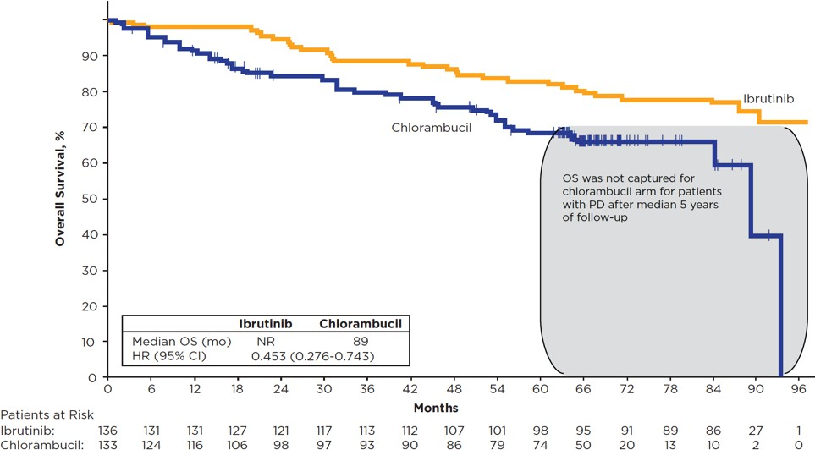
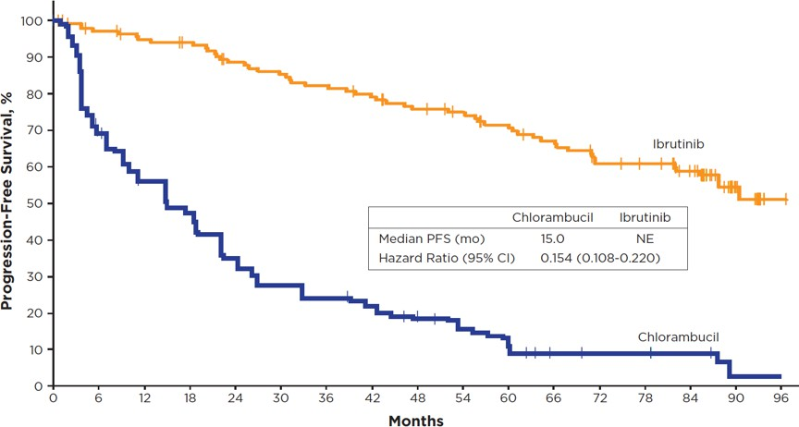
Up to 8 Years of Follow-up in RESONATE-2:
Presenter Notes
2023-08-15 08:04:54
--------------------------------------------
Reference:
1. Barr PM, Owen C, Robak T, et al. Up to 8 years follow-up from RESONATE-2: first-line ibrutinib treatment for patients with chronic lymphocytic leukemia. Blood Adv. 2022 Apr 4:bloodadvances.2021006434. doi:10.1182/bloodadvances.2021006434 Speaker notes:
Patients randomized to IMBRUVICA demonstrated an OS rate of 78% and an estimated PFS rate of 59%, further verifying the long-term value of first line treatment Moderator Follow-up Questions:
Based on 8-year efficacy outcomes, what is reinforced, improved, or reduced?
In what ways may these data mean more to community vs. academic? Have we done enough to communicate this? How would you communicate that to a community-based colleague?
OS and PFS
Overall Survival
59% _{PFS}
ESTIMATED 7-YEAR PFS RATE WITH
Ibrutinib®
Progression-free Survival
78%
9% PFS ESTIMATED 7-YEAR PFS RATE WITH CHLORAMBUCIL
OS
ESTIMATED
7-YEAR OS RATE WITH IMBRUVICA®
78% taking IBRUTINIB were estimated to be alive at 7 years
59% taking IBRUTIINIB were estimated to be progression-free and alive at
7 years vs 9% of patients taking chlorambucil
Reference:
1. Barr PM, Owen C, Robak T, et al. Up to 8 years follow-up from RESONATE-2: first-line ibrutinib treatment for patients with chronic lymphocytic leukemia. Blood Adv. 2022 Apr 4:bloodadvances.2021006434.doi:10.1182/bloodadvances.2021006434

Slide 14

Long term results of A041202: BR vs I vs IR
Schema Primary Endpoint: PFS
P R E
- R E G I S T E R
Bendamustine 90mg/m2 days 1&2 of each 28 day cycle +
Rituximab 375 mg/m2 day 0 cycle 1,
then 500 mg/m2 day 1 cycles 2-6
R A N D O M I Z E
Untreated patients age ≥ 65 who meet IWCLL criteria for CLL treatment
Stratify*
Ibrutinib 420mg daily until disease progression
Ibrutinib 420mg daily until disease progression + Rituximab 375 mg/m2 weekly for 4 weeks starting cycle 2 day 1, then day 1 of cycles 3-6
Stratification
High risk vs intermediate risk Rai Stage
Presence vs absence of del(11q22.3) or del(17p13.1) on FISH performed locally
< 20% vs ≥ 20% Zap-70 methylation of CpG 3 performed centrally
Woyach et al ASH 2021

Slide 15
Progression-free Survival
1.0
Median follow-up: 55 months
0.9
Pairwise Comparisons
Progression-free Survival Probability
0.8
I vs BR: Hazard Ratio 0.36
95% CI: 0.26-0.52
P <0.0001
0.7
0.6
0.5
0.4
IR vs BR:
Hazard Ratio 0.36
95% CI: 0.25-0.51
P <0.0001
0.3
0.2
Arm
Arm 1 (BR)
Arm 2 (I)
Arm 3 (IR)
Events/Total Time-Point PFS Est. (95% CI) Time-Point PFS Est. (95% CI)
94/183
48/182
47/182
24 months
24 months
24 months
0.75 (0.67-0.81)
0.87 (0.80-0.91)
0.87 (0.81-0.91)
Censor
48 months
48 months
48 months
0.47 (0.39-0.55)
0.76 (0.69-0.82)
0.76 (0.69-0.82)
0.1
0.0
IR vs I: Hazard Ratio 0.99
0
12
24
36
48
60
72
84
 |  |  |  |  | Time (Months) Patients-at-Risk | 95% CI: 0.66-1.48
Arm 1 (BR) | 183 | 139 | 114 | 87 | 63 | 20 | 1 | 0 | P = 0.96
Arm 2 (I) | 182 | 158 | 142 | 131 | 114 | 52 | 4 | 0
Arm 3 (IR) | 182 | 156 | 142 | 130 | 117 | 44 | 2 | 0
Woyach et al ASH 2021

Slide 16
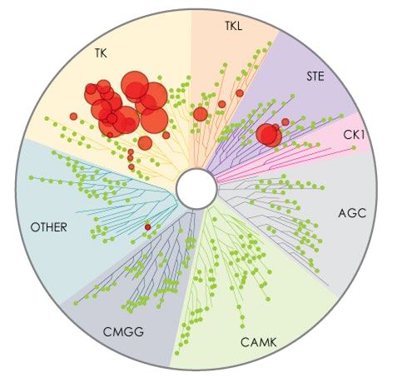
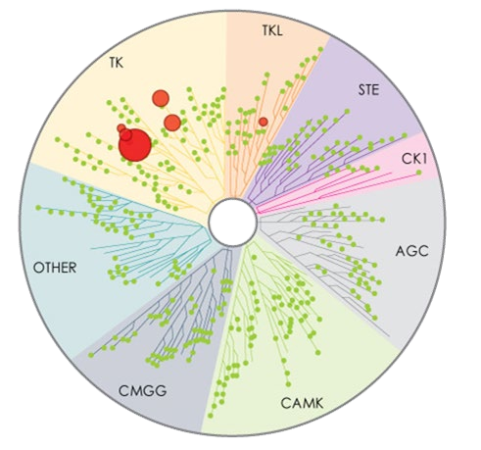
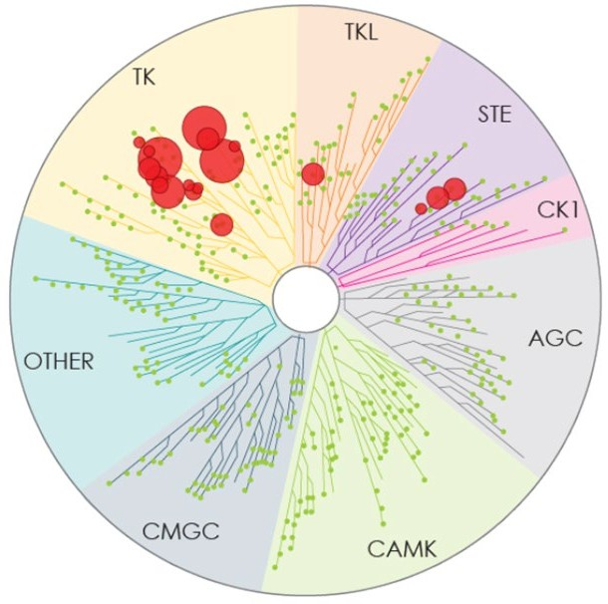
Kinase Selectivity of BTK Inhibitors
Larger red circles represent stronger inhibition
Kinase Selectivity Profiling at 1 μmol/L (in vitro)
 |  | IC₅₀/EC₅₀ (nM)
Kinase | Ibrutinib | Acalabrutinib | Zanubrutinib
BTK | 1.5 | 5.1 | 0.5
TEC | 10 | 126 | 44
ITK | 4.9 | >1000 | 50
BMX | 0.8 | 46 | 1.4
EGFR | 5.3 | >1000 | 21
ERBB4 | 3.4 | 16 | 6.9
JAK3 | 32 | >1000 | 1377
BLK | 0.1 | >1000 | 2.5
Ibrutinib
Acalabrutinib
Kaptein. ASH 2018. Abstr 1871.
Zanubrutinib

Slide 17

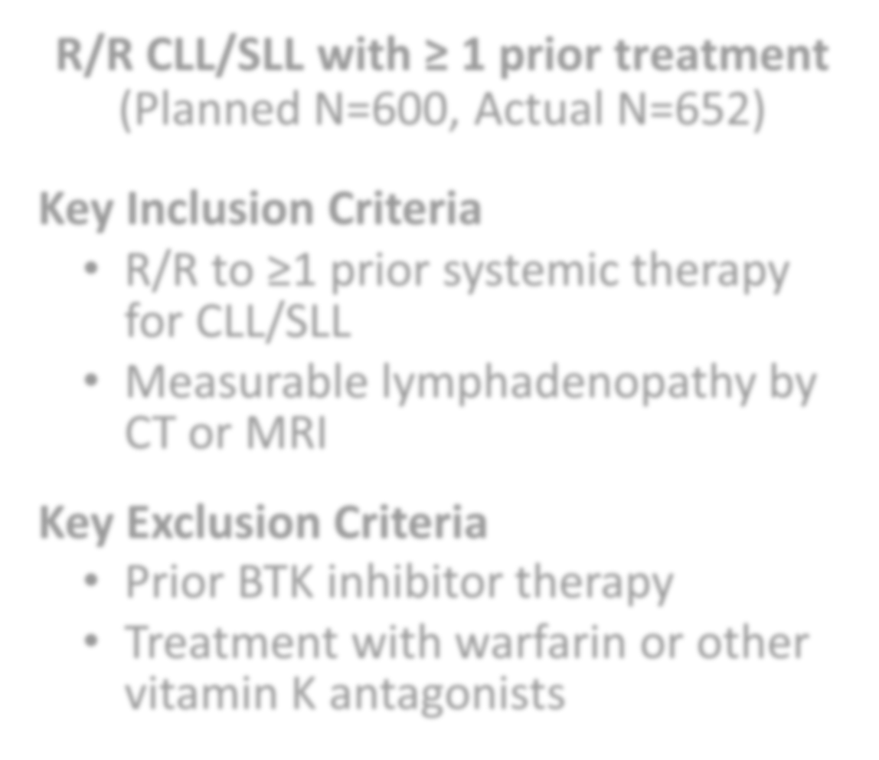
ALPINE Study Design
Presenter Notes
2023-08-15 08:04:50
--------------------------------------------
Other Key Inclusion Criteria: Age 18 years or older, ECOG performance status 0-2, Adequate bone marrow function, Adequate organ function.
Other Key Exclusion Criteria: History of severe bleeding, Known infection with HIV, Active hepatitis B or C, Clinically significant cardiovascular disease
ORR as PR+CRi+CR prespecified in the protocol and as requested by FDA. Of note, the same in acalabrutinib study. The first 415 patients to be analyzed at interim analysis is per protocol to ensure adequate follow-up.
Noninferiority of overall response rate between zanubrutinib and ibrutinib was tested at a prespecified overall response rate interim analysis in the first 415 randomized patients as well as at overall response rate final analysis for all randomized patients, approximately 12 months after 600 patients had been randomized
R/R CLL/SLL with ≥ 1 prior treatment
(Planned N=600, Actual N=652)
Key Inclusion Criteria
R/R to ≥1 prior systemic therapy
for CLL/SLL
Measurable lymphadenopathy by CT or MRI
Key Exclusion Criteria
Prior BTK inhibitor therapy
Treatment with warfarin or other vitamin K antagonists
Zanubrutinib 160 mg BID
R 1:1
Ibrutinib 420 mg QD
Stratification factors: age, geographic region, refractoriness, del(17p)/TP53
Treatment until disease progression or unacceptable toxicity
Brown JR et al. N Engl J Med 2023 Jan 26; 388(4):319-332

Slide 18
Zanubrutinib Showed Higher ORR Assessed by IRC
100
2.4
4.3
2.2
4.9
0.9
NA+DC+NE PD
SD
PR-L PR+nPR CR+CRi
5.5
10.5
Best Overall Response (%)
80
7.4
60
79.5
ORR=86.2%
40
69.8
ORR=75.7%
Nominal, 2- sided P=.0007
20
6.7
5.8
0
Zanubrutinib Ibrutinib
CR, complete response; CRi, complete response with incomplete bone marrow recovery; nPR, nodular partial response; PR, partial response; PR-L, partial response with lymphocytosis; SD, stable response; PD, progressive disease; NA, not assessed; DC, discontinued prior to first assessment; NE, not evaluable.
Data cutoff: 8 Aug 2022
Brown JR et al. N Engl J Med 2023 Jan 26; 388(4):319-332
39

Slide 19
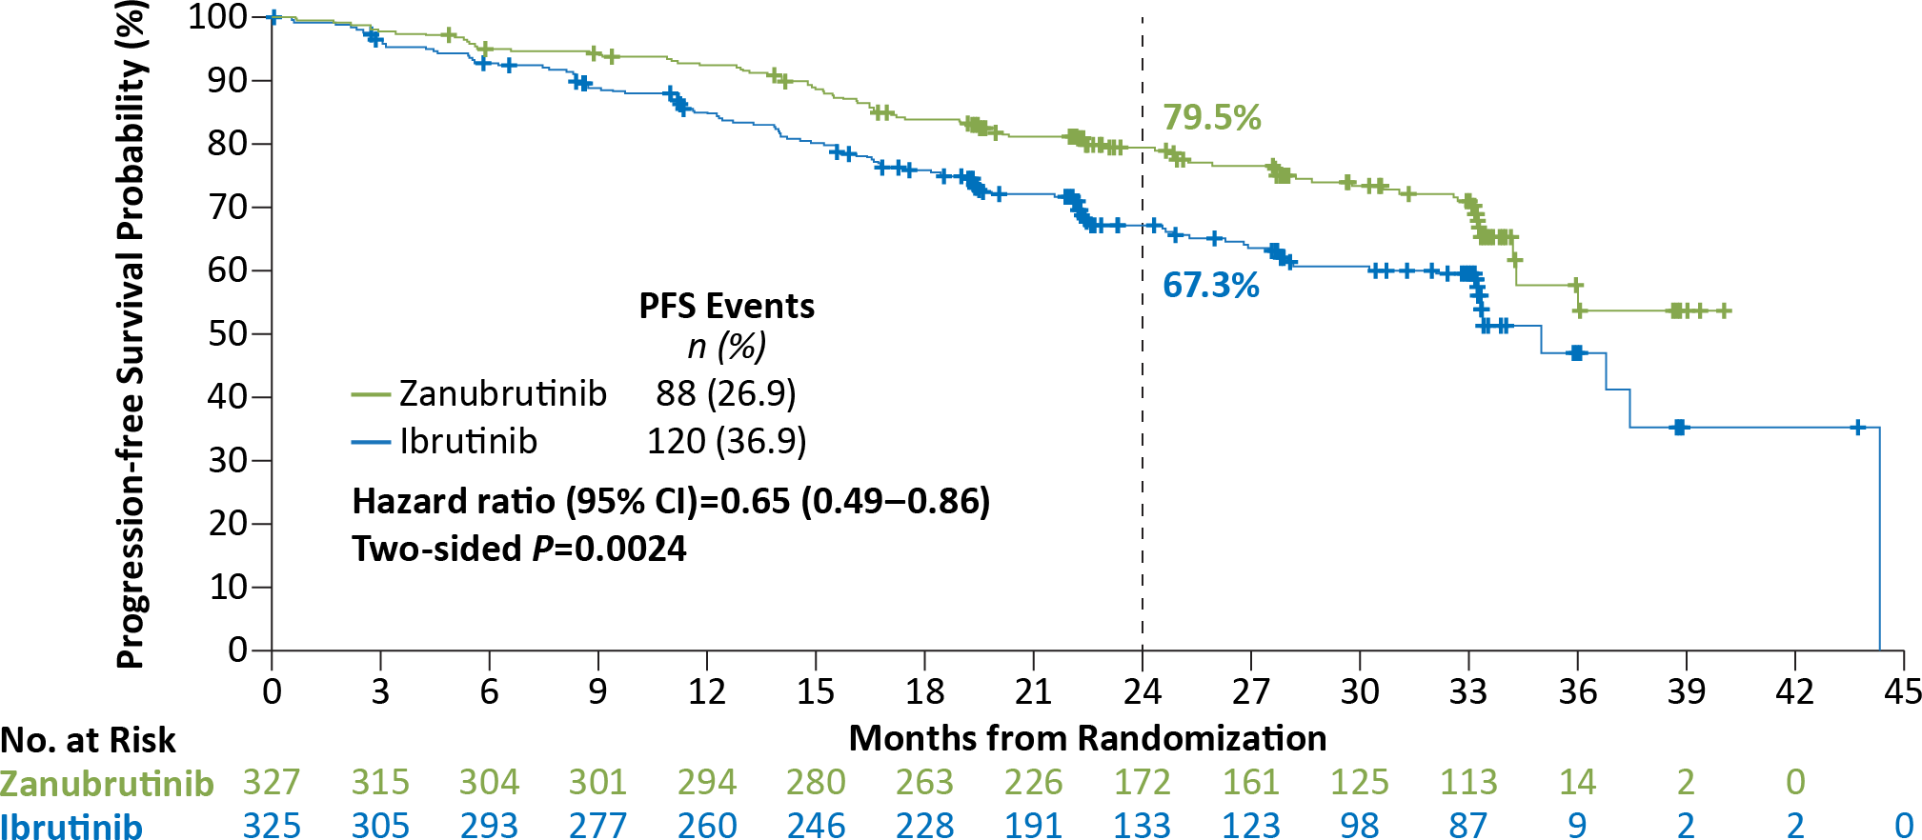
Zanubrutinib PFS by IRC Significantly Superior to Ibrutinib
Median study follow-up of 29.6 months
Brown JR et al. N Engl J Med 2023 Jan 26; 388(4):319-332
Data cutoff: 8 Aug 2022
40

Slide 20
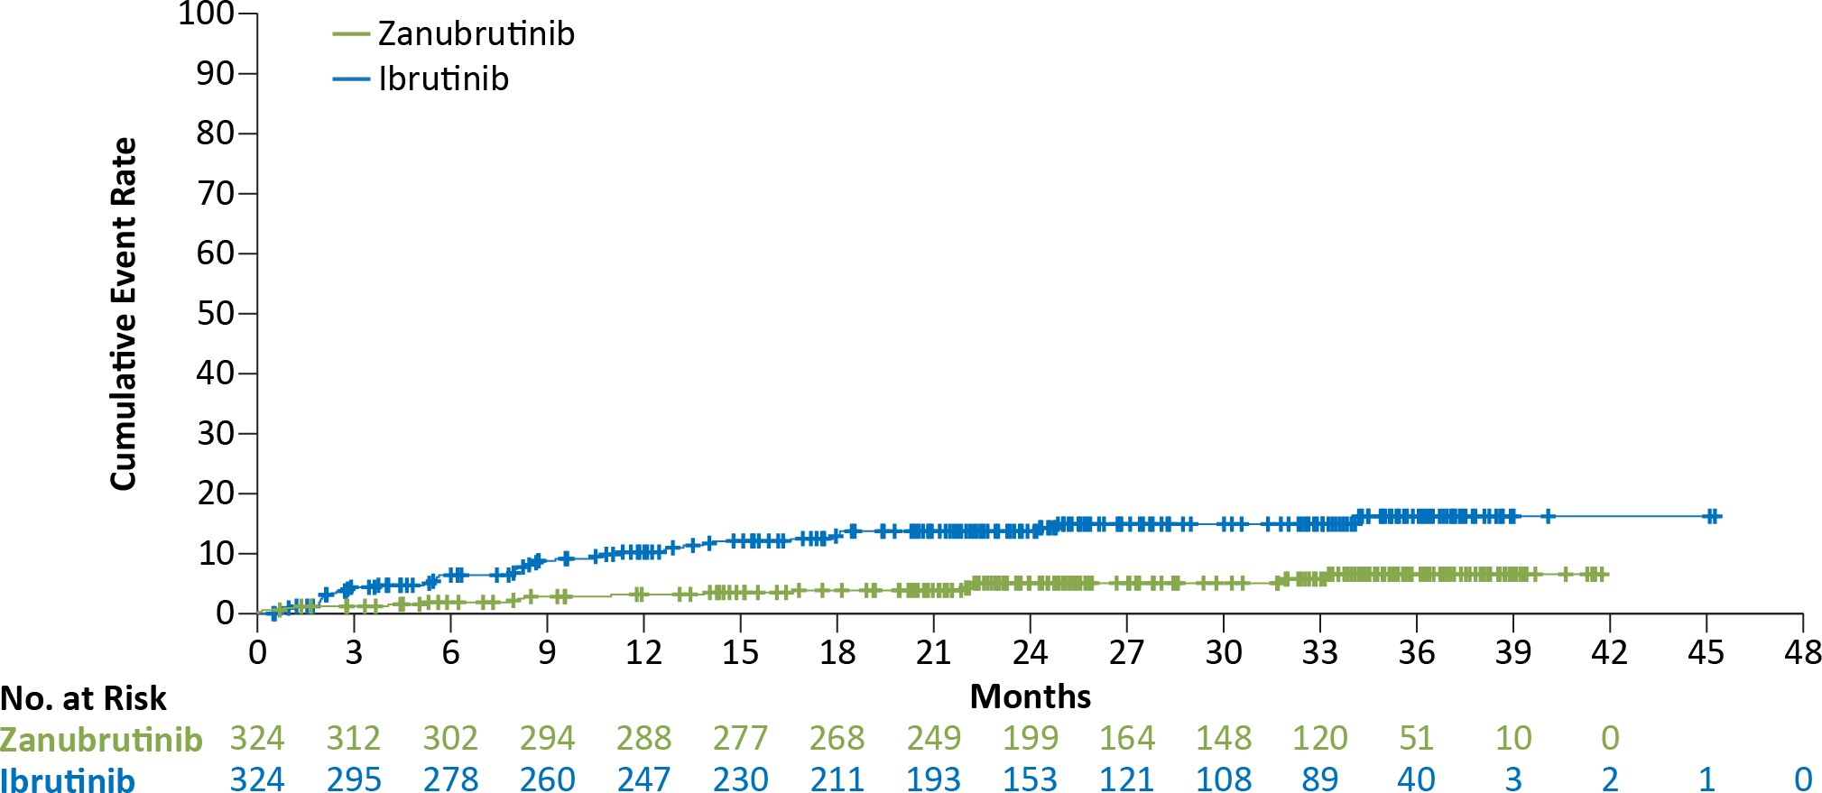
Fewer Atrial Fibrillation/Flutter Events With Zanubrutinib
Atrial fibrillation/flutter occurred in fewer zanubrutinib- than ibrutinib-treated patients
(17 [5.2%] vs 43 [13.3%]; nominal, 2-sided P=.0004)
Data cutoff: 8 Aug 2022
Brown JR et al. N Engl J Med 2023 Jan 26; 388(4):319-332
41

Slide 21





SEQUOIA (BGB-3111-304)
Study Design
Arm A: Zanubrutinib
160 mg bid until PD, intolerable toxicity, or end of study
Cohort 1 without del(17p) by central FISH planned n ~450
open-label
Key Eligibility Criteria
R 1:1
Stratification Factors
Arm B: Bendamustine (90 mg/m² D1 & D2)
+ Rituximab (375 mg/m² C1, then 500 mg/m² C2-C6)
x 6 cycles
Untreated CLL/SLL
Met iwCLL criteria for treatment
≥65 y of age OR unsuitable for treatment with FCRª
Anticoagulation and CYP3A inhibitors allowed
ClinicalTrials.gov: NCT03336333
Age, Binet stage,
IGHV status, geographic region
Cohort 2 with del(17p) planned n ~100
Arm C: Zanubrutinib
Cohort 3¹ with del(17p) planned n ~80
Arm D: Zanubrutinib + Venetoclax
ªDefined as Cumulative Illness Rating Scale >6, creatinine clearance <70 mL/min, or a history of previous severe infection or multiple infections within the last 2 years.
C, cycle; CLL/SLL, chronic lymphocytic leukemia/small lymphocytic lymphoma; CYP3A, cytochrome P450, family 3, subfamily A; D, day; del(17p), chromosome 17p deletion; FCR, fludarabine, cyclophosphamide, and rituximab; FISH, fluorescence in-situ hybridization; IRC, independent review committee; IGHV, gene encoding the immunoglobulin heavy chain variable region; iwCLL, International Workshop on CLL; ORR, overall response rate; PD, progressive disease; R, randomized.
1. Tedeschi A, et al . ASH 2021. Abstract 67.
Tam et al Lancet Oncol 2022 Aug; 23(8): 1031-43

Slide 22
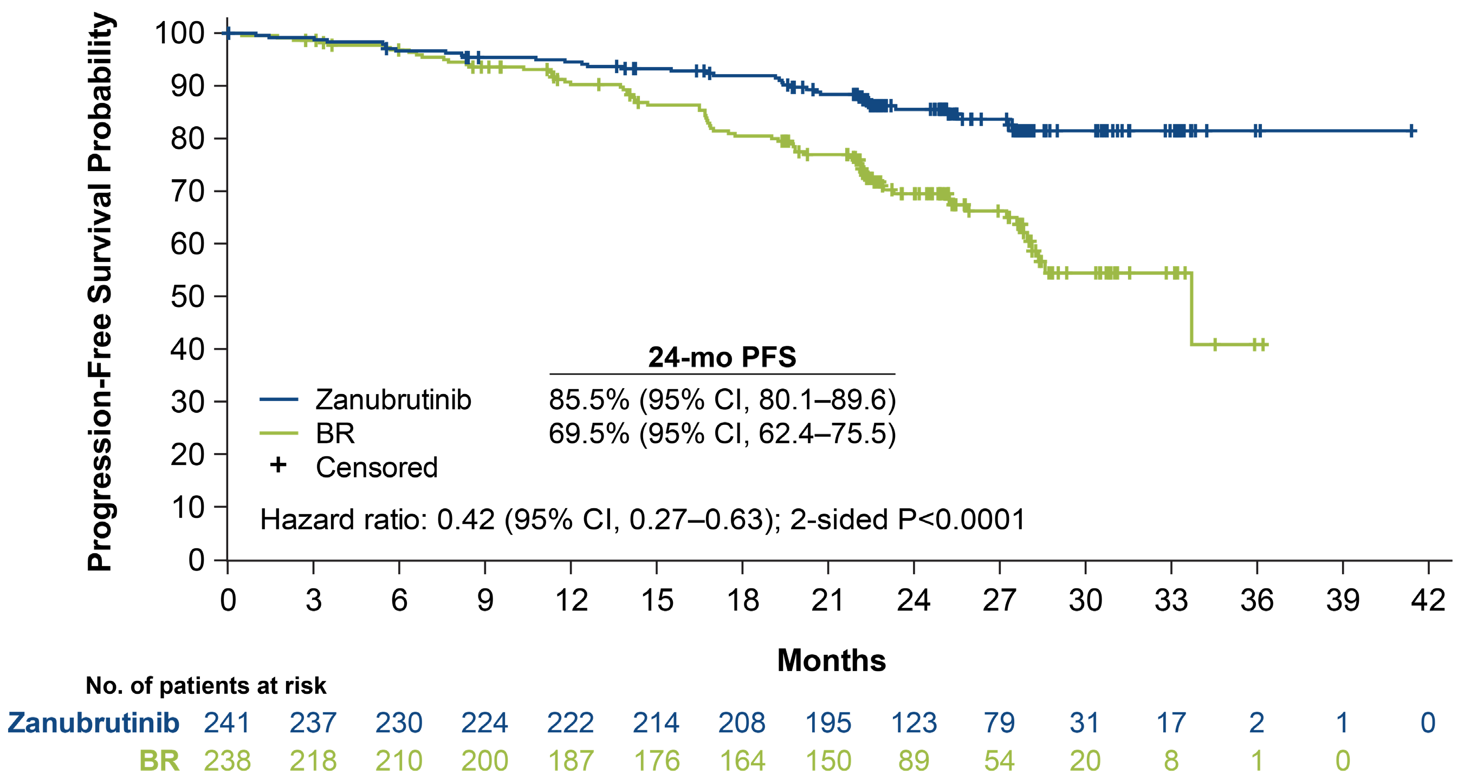
Sequoia: Progression-Free Survival Per IRC Assessment
BR, bendamustine + rituximab; IRC, independent review committee; PFS, progression-free survival.

Slide 23


ELEVATE-RR: Phase 3 Randomized Non-inferiority Open-Label Trial
Patients (N=533) Key Inclusion Criteria
Adults with previously treated CLL requiring therapy (iwCLL 2008 criteria¹)
Presence of del(17p) or del(11q)ª
ECOG PS of ≤2
Stratification
del(17p) status (yes or no)
ECOG PS (2 vs ≤1)
No. prior therapies (1–3 vs ≥4)
R A N D O M I Z E
1:1
Primary endpoint
Non-inferiority on IRC-assessed PFS^{c}
Secondary endpoints (hierarchical order):
Incidence of any grade atrial fibrillation/flutter
Incidence of grade ≥3 infection
Incidence of Richter transformation
Overall survival
Acalabrutinib^{b} 100 mg PO BID
Ibrutinib^{b} 420 mg PO QD
Key exclusion criteria: Significant CV disease; concomitant treatment with warfarin or equivalent vitamin K antagonist; prior treatment with ibrutinib, a BCR inhibitor, (eg, BTK , PI3K, or Syk inhibitors) or a BCL-2 inhibitor (eg, venetoclax)
NCT02477696 (ACE-CL-006).
ªBy central laboratory testing; ^{b}continued until disease progression or unacceptable toxicity; ^{c}conducted after enrollment completion and accrual of ~250 IRC-assessed PFS events.
Afib/flutter, atrial fibrillation/flutter; BCL-2, B-cell leukemia/lymphoma-2; BID, twice daily; BTK, Bruton tyrosine kinase; CLL, chronic lymphocytic leukemia; CV, cardiovascular; ECOG PS, Eastern Cooperative Oncology Group performance status; IRC, independent review committee; iwCLL, International Workshop on CLL; PFS, progression-free survival; PI3K, phosphatidylinositol 3-kinase; PO, orally; QD, once daily.
1. Hallek M, et al. Blood. 2008;111:5446-56.
Byrd JC et al J Clin Oncol. 2021 Nov 1:39(31):3441-52

Slide 24
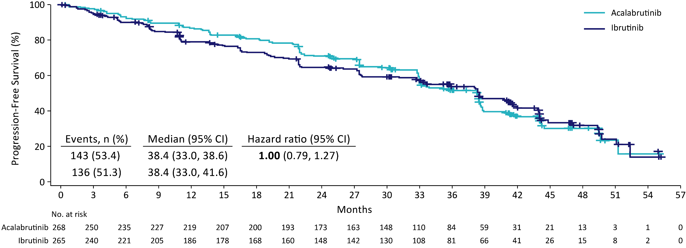
Primary Endpoint: Non-inferiority Met on IRC-Assessed PFS
Median follow-up: 40.9 months (range, 0.0–59.1).
CI, confidence interval; IRC, independent review committee; PFS, progression-free survival.
Byrd JC et al J Clin Oncol. 2021 Nov 1:39(31):3441-52

Slide 25
ELEVATE TN Study Design (ACE-CL-007)
Presenter Notes
2023-08-15 08:04:55
--------------------------------------------
Subjects with treatment naïve CLL age > 65 or < 65 with CIRS > 6 or creatinine clearance <70 ml/min were stratified according to Deletion 17P, ECOG 0-1 vs 2, and geographic region.
They were then randomized 1:1:1 to receive either acalabrutinib in combination with obinutuzumab, acalabrutinib alone, or standard obinutuzumab / chlorambucil. To reduce infusion reactions, those patients randomized to acalabrutinib/obinutuzumab received one month of BTK inhibitor prior to initiating anti-CD20 therapy The primary endpoint was PFS for acalabrutinib obinutuzumab versus obinutuzumab chlorambucil. Secondary endpoints included PFS of acalabrutinib monotherapy vs control, ORR, TTNT, OS, and safety.
Interim analysis was triggered when either 2/3 of 111 events had occurred or based upon time from last enrolled patient. Crossover from control to acalabrutinib monotherapy was allowed after central confirmation of progression
Sharman, ASH 2019
Treatment-naive CLL (N=535)
Age ≥65 or
<65 years with coexisting conditions:
Acalabrutinibª + Obinutuzumab (G)^{b}
Primary endpoint
PFS (assessed by IRC) Acala-G vs G-Clb
Key secondary endpoints
PFS acalabrutinib vs G-Clb
ORR (assessed by IRC and investigator)
Time to next treatment
OS
Safety
R A N D O M I Z E
1:1:1
ª100 mg PO BID
^{b}1000 mg IV on D1, 2, 8, and 15 of Cycle 2, + D1 of subsequent 28-day cycles for a total of 6 cycles
Acalabrutinib
100 mg PO BID
CIRS score >6, or
creatinine clearance <70 mL/min
Stratification
del(17p), y vs n
ECOG PS 0-1 vs 2
Geographic region (N America, W Europe, or other)
Obinutuzumab (G)^{c} + Chlorambucil^{d}
^{c}1000 mg IV on D1, 2, 8, and 15 of Cycle 1, + D1 of subsequent 28-day cycles for a total of 6 cycles
^{d}0.5 mg/kg PO on D1 + 15 of each 28-day cycle for 6 cycles
Crossover from G-Clb to acalabrutinib was allowed after IRC-confirmed progression
Interim analysis was planned based on events (after occurrence of ~111 IRC-assessed PFS events in the combination therapy arms) or after 24 months if the required number of events was not met by this time
Acala, acalabrutinib; CIRS, Cumulative Illness Rating Scale; ECOG PS, Eastern Cooperative Oncology Group performance status; IRC, independent review committee; IV, intravenously; OS, overall survival; PO, orally
Sharman et al. Lancet. 2020 Apr 18;395(10232):1278-1291.

Slide 26
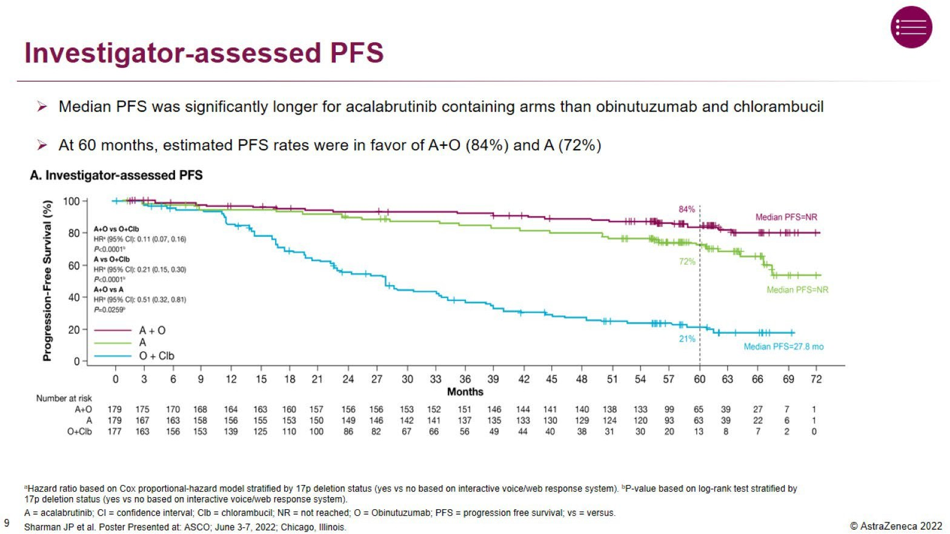
ASCO 2022

Slide 27
Venetoclax: Potent and Selective Bcl-2 Inhibition
Small molecule, orally bioavailable
High affinity for Bcl-2, lower affinity for BCL-xL, Mcl-1
>100-fold improved functional selectivity for Bcl-2 over Bcl-x_{L} in assays with tumor cell lines
N2O _{H} N
₂O S
O NH
O
O
N
N H
N
N
ABT-199
C
l
 | Affinity |  |  |  | Cellular Efficacy, EC₅₀, nM
 | TR FRET K_{i}, nM |  |  |  | FL5.12, 3% FBS |  |  | Human tumor cell lines, 10% HS
Agents | Bcl-2 | Bcl-x_{L} | Bcl-w | Mcl-1 | Bcl-2 | Bcl-x_{L} | Functional Selectivity | RS4;11 (Bcl-2) | H146 (Bcl-x_{L})
Navitoclax | 0.04 | 0.05 | 7 | >224 | 20 | 13 | 0.6 | 110 | 75
ABT-199 | < 0.01 | 48 | 21 | >440 | 4 | 261 | 65 | 12 | 3600
Souers et al. Nat Med. 2013 Feb;19(2):202-8.

Slide 28
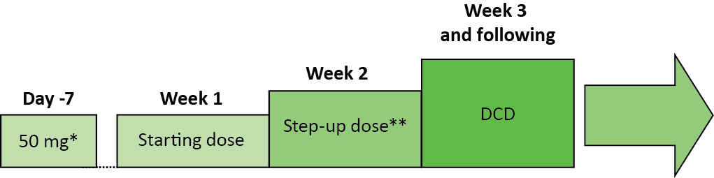
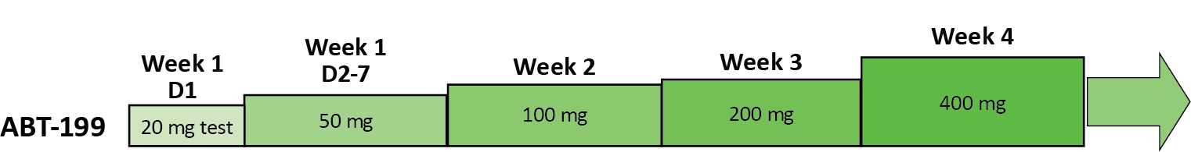
Dosing Schedule of Venetoclax: Dose Escalation Schematic
Dose Escalation Scheme
Presenter Notes
2023-08-15 08:04:51
--------------------------------------------
There are 53 patients in the Dose Escalation Cohort and 11 in the Expansion Safety Cohort.
*3 patients (1 each in cohorts 2, 3, & 5) received ABT-199 20 mg as initial dose.
**Step-up doses range from 100 to 400 mg. DCD = Designated Cohort Dose
Lead-in to Designated Cohort Dose - Expanded Safety Cohort
c
Median time on study 10.9 months
Seymour et al. EHA 2014

Slide 29
Venetoclax
CRR and ORR Rates by Subgroups
Variable | No. | ORR % | CR %
All patients | 116 | 79 | 20
17p deletion | 31 | 71 | 16
Unmutated | 46 | 76 | 17
Flu - refractory | 70 | 79 | 16
Prior Rx ≥ 4 | 56 | 73 | 16
Age ≥ 70 | 34 | 71 | 21
Nodes > 5cm | 67 | 78 | 8
Of 23 CR patients, 17 tested for MRD in BM, 6 (35%) negative
Roberts et al N. Engl J Med 2016; 374; 311-22.

Slide 30


MURANO (NCT02005471): study design and prior findings
Global, Phase III, open-label, randomized study¹
Main study
VenR combination therapy (n=194)
Venetoclax
400 mg orally once daily
Rituximab
375 mg/m² C1D1
500 mg/m² C2–6, D1
BR (n=195)
Bendamustine
70 mg/m² C1–6, D1, D2
Rituximab
375 mg/m² C1D1
500 mg/m² C2–6, D1
Substudy
Subsequent retreatment with VenR or crossover from BR to
VenR following
PD*
Venetoclax monotherapy
Venetoclax
400 mg orally once daily
R/R CLL (N=389)
Ven 5-week ramp-up 20–400 mg
Stratified by:
del(17p) by local labs
Responsiveness to prior therapy
Geographic region
Rand
1:1
Start
5 weeks
6 months
C6 (EOCT)
max 2 years from C1D1
C24 (EOT)
7 years’ follow up
Superior PFS and OS wa_{C}s₁ observed with fixed-duration VenR vs BR in patients with R/R CLL¹
At 48 months of follow up, deep responses with uMRD† were associated with favorable PFS²
Kater et al, EHA 2023
Seymour JF, et al. N Engl J Med
2018;378(12):1107–20.
Kater AP, et al. J Clin Oncol 2020;38(34)4042–54.

Slide 31
PFS and OS benefits with VenR over BR were sustained at 7 years
 | Median PFS (95% CI), months | HR* (95% CI) | 7-year PFS (%)
VenR (n=194) | 54.7 (52.3–59.9) | 0.23 (0.18–0.29) Stratified P-value <0.0001† | 23.0
BR (n=195) | 17.0 (15.5–21.7) |  | NE
 | Median OS (95% CI), months | HR‡ (95% CI) | 7-year OS (%)
VenR (n=194) | NE | 0.53 (0.37–0.74) Stratified P-value <0.0002† | 69.6
BR (n=195) | 87.8 (70.1–NE) |  | 51.0
100
100
80
80
PFS
60
60
OS
40
40
20
20
0
Censored
0
Censored
0 6 12 18 24 30 36 42 48 54 60 66 72 78 84 90 96
0 6 12 18 24 30 36 42 48 54 60 66 72 78 84 90 96
Time (month)
No. of Patients at Risk
Time (month)
No. of Patients at Risk
194190185179176174170167161150142136133125119 111 107102 88 79 68 63 57 54 46 45 37 34 19 14 4 4 1
194190185183182179178176173168166165164163161 160 159158156153151150149147141136131125 82 53 19 11 4
195178166144129104 85 80 66 56 45 40 32 27 24 21 14 13 10 9 9 8 6 5 4 3 3 2
195181175167162155 152150147141140138134131124 121 115110107103102 99 97 94 88 86 83 78 55 35 17 3
Median follow up for efficacy (range) was 86.8 months (0.3–99.2) for VenR and 84.4
months (0.0−95.0) for BR
No new safety signals were identified since the 5-year data cut,¹ with all patients outside of the AE reporting window§
*Stratified HR is presented, unstratified HR=0.25. †P-values are descriptive only. ‡Stratified HR is presented, unstratified HR=0.54. §All AEs were reported until
28 days after the last dose of Ven or 90 days after last dose of R, whichever was longer. After this, only deaths, serious AEs, or AEs of concern that were believed to be Ven-related were reported. AE, adverse event; CI, confidence interval; HR, hazard ratio; NE, not estimable.

Slide 32
uMRD at EOT is associated with improved outcomes in the VenR arm
Presenter Notes
2023-08-15 08:04:53
--------------------------------------------
Unstratified HR (95% CI), unstratified P-value
Low MRD+ vs uMRD: PFS, 2.44 (1.39–4.29), P=0.0001; OS, 1.33 (0.48–3.75), P=NS
High MRD+ vs uMRD: PFS, 20.04 (9.11–44.06), P<0.0001; OS, 3.55 (1.35–9.35), P=0.0152 Low MRD+ vs High MRD+: PFS, 6.83 (2.74–17.06), P<0.0001; OS, 2.64 (0.80–8.65), P=NS
Patients who completed 2 years of Ven without PD* | Median PFS since EOT (95% CI), months | HR (95% CI); P-value†
uMRD (n=83) | 52.5 (44.5–61.5)
Low MRD+ (n=23) | 29.3 (20.2–37.5) | vs uMRD: 3.46 (1.75–6.86); <0.0001
High MRD+ (n=12) | 4.6 (2.8–8.3) | vs uMRD: 17.22 (5.70–52.00); <0.0001
Patients who completed 2 years of Ven without PD* | Median OS since EOT (95% CI), months | HR (95% CI); P-value†
uMRD (n=83) | NE (NE–NE)
Low MRD+ (n=23) | NE (62.7–NE) | vs uMRD: 1.07 (0.34–3.35); NS
High MRD+ (n=12) | 63.1 (51.5–NE) | vs uMRD: 2.39 (0.73–7.80); NS
100
Landmark PFS
80
100
60
80
40
Landmark OS
60
20
40
0
Censored
20
0 3 6 9 12 15 18 21 24 27 30 33 36 39 42 45 48 51 54 57 60 63 66 69 72 75 78
Censored
EOT
No. of Patients at Risk
uMRD 83 79 79 79 77 73 70 69 65 65 54 52 48 47 44 39 37 35 30 17 15 6
0
Time (month)
0 3 6 9 12 15 18 21 24 27 30 33 36 39 42 45 48 51 54 57 60 63 66 69 72 75 78
Low MRD+ 23 23 23 21 20 18 16 15 13 13 11 10 7 6 5 3 3 3 3 3 1
High MRD+
4 2 1 1
EOT
No. of Patients at Risk
Time (month)
uMRD 83 81 81 81 81 81 80 80 80 80 79 78 78 76 76 74 72 71 68 48 35 16 11 4 3 1
Low MRD+ 23 23 23 23 23 22 22 22 21 21 21 21 20 20 20 20 19 19 19 16 11 5 1
12 8 6 2 2 1 1 1 1 1
High MRD+ 12 12 12 12 12 11 11 10 10 10 10 9 9 9 9 9 9 9 8 7 5 2
Achievement of uMRD was associated with prolonged PFS in VenR-treated patients
Low MRD+ is defined as ≥1 CLL cell/10,000 leukocytes to <1 CLL cell/100 leukocytes, high MRD+ is defined as ≥1 CLL cell/100 leukocytes. Stratified HR (95% CI) for Low MRD+ vs High MRD+: PFS, 3.22 (1.04–9.97), P=0.0350; OS, 2.27 (0.44–11.69), P=NS.
*Investigator-assessed PD according to iwCLL criteria. †Stratified HRs and P-values are presented, P-values are descriptive only. NS, not significant.

Slide 33
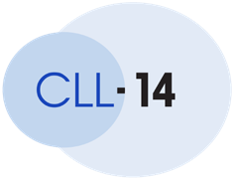
CLL 14 TRIAL DESIGN
VENETOCLAX AND OBINUTUZUMAB VS CHLORAMBUCIL AND OBINUTUZUMAB
Venetoclax– Obinutuzumab 6 cycles
Venetoclax
6 cycles
Previously untreated patients with CLL and coexisting medical conditions CIRS > 6 and/or CrCl < 70mL/min Enrolment from 2015 to 2016
Follow-up Phase
Primary endpoint: Progression-free survival
1:1
randomization
Key secondary endpoints: Response, Minimal Residual Disease, Overall
Survival
Chlorambucil– Obinutuzumab 6 cycles
Chlorambuci
l
6 cycles
Current median observation time: 76.4 months
Al Sawaf et al EHA 2023

Slide 34
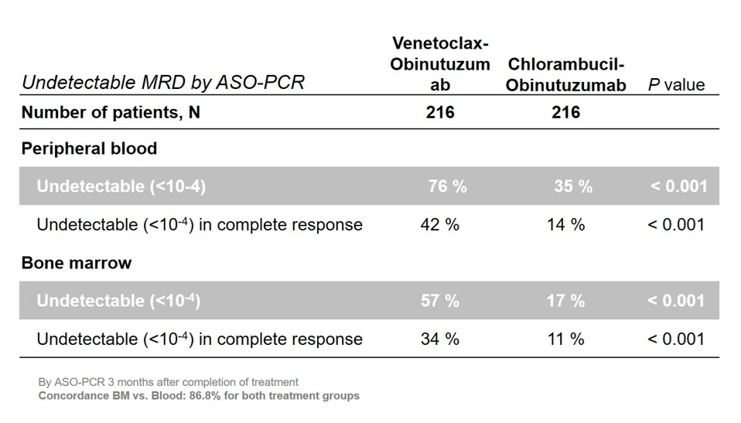
MRD Status by Regimen
ASH 2019

Slide 35
PROGRESSION-FREE SURVIVAL
Investigator-assessed PFS
100
Cumulative progression-free survival
90
Median PFS Ven-Obi: 76.2 months
Clb-Obi: 36.4 months
80
70
End of treatment
60
50
40
30
6-year PFS rate
Ven-Obi: 53.1%
Clb-Obi: 21.7%
20
10
Ven-Obi Clb-Obi
0
24 36 48 60 72
Time to Event [PFS] from Randomization (months)
0
12
84
HR 0.40, 95% CI
[0.31-0.52] P<0.0001
Ven-Obi | 216 | 193 | 177 | 160 | 139 | 112 | 79 | 3
Clb-Obi | 216 | 185 | 130 | 101 | 67 | 50 | 36 | 3
Al Sawaf et al EHA 2023

Slide 36
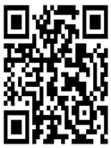
Phase 3 GLOW Study (NCT03462719)
Eligibility criteria
Previously untreated CLL
≥ 65 years of age or
< 65 years with CIRS > 6 or CrCl < 70 mL/min
No del(17p) or known
TP53 mutation
ECOG PS 0-2
Ibrutinib 420 mg daily for a 3-cycle lead-in
followed by
Ibrutinib + Venetoclax for 12 cycles
(venetoclax ramp-up 20-400 mg over 5 weeks beginning C4)
Patients with IRC-
N = 211
confirmed PD and active disease requiring treatment are eligible to receive subsequent therapy with single-agent ibrutinibª
R 1:1
Chlorambucil
0.5 mg/kg on D1 and D15 for 6 cycles
+
Obinutuzumab
1000 mg on D1-2, D8, D15 of C1, and D1 of C2-6
Stratified by
IGHV
mutational status and presence of del(11q)
Primary end point: IRC-assessed PFS
Key secondary end points: uMRD rates, response rates, overall survival, time to next treatment, and safety
Current analysis
Median study follow-up of 46 months (range, 1.7-51.7)
MRD assessed in peripheral blood in responders by NGS
Neimann et al ASH 2022
74

Slide 37
uMRD Rate < 10⁻⁴ Was Significantly Higher in Both Compartments With Ibr+Ven
MRD at EOT+3
months
Bone Marrow Ibr+Ven
(N = 106)
Peripheral Blood
100
90
80
70
60
50
40
30
20
10
0
Clb+O
(N = 105)
Ibr+Ven
(N = 106)
Clb+O
(N = 105)
Patients With uMRD < 10⁻⁴ (%)
p < 0.0001
p = 0.0259
51.9
54.7
39.0
17.1
Rate of uMRD was significantly higher with Ibr+Ven vs Clb+O in BM and PB
uMRD concordance in PB/BM: 92.9% for Ibr+Ven vs 43.6% for Clb+O
MRD results by next-generation sequencing at EOT+3.
BM, bone marrow; EOT, end of treatment; PB, peripheral blood.
75

Slide 38
GLOW: Progression-Free Survival by IRC Remained Superior For Ibr+Ven Versus Clb+O With 4 Years of Study Follow-up
Progression-Free Survival (IRC)
100
90
80
70
60
50
40
30
20
10
0
Ibr+Ven reduced the risk of progression or death by 79% versus Clb+O
– HR 0.214 (95% CI, 0.138-
0.334); p < 0.0001
Estimated 3.5-year PFS rates:
74.6% for Ibr+Ven
24.8% for Clb+O
Progression-free survival (%)
Ibr+Ven
74.6%
Clb+O
24.8%
End of Ibr+Ven
HR 0.214 (95% CI, 0.138-0.334); p < 0.0001
0 3 6 9 12 15 18 21 24 27 30 33 36 39 42 45 48
End of Clb+O
51
Months from date of randomization
Patients at risk
Ibr+Ven | 106 | 98 | 98 | 94 | 92 | 91 | 90 | 88 | 87 | 85 | 80 | 79 | 76 | 74 | 52 | 48 | 2 | 0
Clb+O | 105 | 104 | 101 | 97 | 95 | 65 | 56 | 50 | 43 | 38 | 34 | 31 | 30 | 28 | 14 | 12 | 1 | 0
Median study follow-up: 46 months
IRC, independent review committee; CI, confidence interval; HR, hazard ratio.
Neimann et al ASH 2022
76

Slide 39
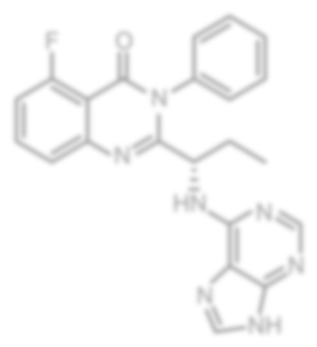
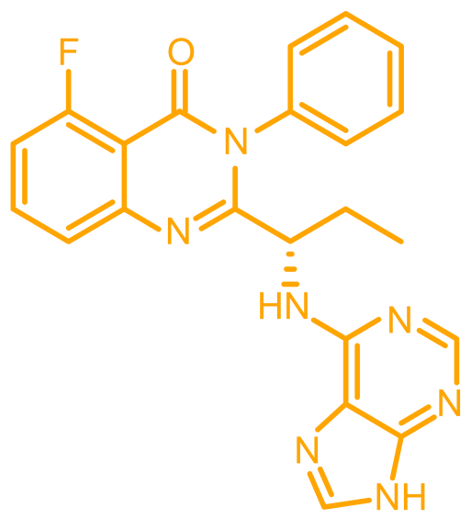


Idelalisib is an Orally Bioavailable Small Molecule That Inhibits PI3K Delta Potently and Selectively
Idelalisib
Class I PI3K Isoform | Alpha | Beta | Gamma | Delta
Cell- Based Activity | PDGF- induced pAKT | LPA-induced pAKT | fMLP- induced CD63+ | FcεR1- induced CD63+
EC₅₀ (nM) | >20,000 | 1,900 | 3,000 | 8
Selectivity relative to Class I PI3K isoforms involved in insulin signaling and other physiological functions
No off-target activity against Class II or III PI3K, mTOR, or DNA-PK
No off-target activity seen in screen of >350 protein kinases (Ambit KINOMEscan™)
Lannutti et al. Blood. 2011 Jan 13;117(2):591-4.

Slide 40
Idelalisib and Rituximab
Approved at 150 mg bid for relapsed CLL based on randomized trial of idelalisib + rituximab vs placebo and rituximab
Idelalisib given to PD or toxicity, rituximab given for 6 months only
Median PFS 23 months vs 5.5 months
OR 85%, 1CR
Common side effects are transaminitis, hold if grade 3-4 and resume at same dose or decrease dose to 100 mg bid at second occurrence
Serious side effects are pneumonitis ( <5%) and late colitis (10-20%)
Frontline randomized trials halted by FDA for increased aggregate deaths ( infections), also “itises” markedly increased
Sharman et al. J Clin Oncol. 2019 Jun 1;37(16):1391-1402. Epub 2019 Apr 17.

Slide 41
Duvelisib
PI3K delta/gamma inhibitor, dose is 25 mg po bid
Approved in relapsed CLL based on randomized trial versus ofatumumab
Duvelisib given to PD or toxicity; ofatumumab given 6 months
OR 74%, all PR; median PFS 13 vs 10 months, no difference in OS
Side effect profile similar to idelalisib but toxicities may be reduced in frequency
O’Brien et al. Am J Hematol. 2018 Nov;93(11):1318-1326. Flinn et al. J Clin Oncol. 2019 Apr 10;37(11):912-922.

Slide 42
Conclusions - CLL
Ibrutinib produces longer PFS (in frontline therapy) then FCR, BR, and Chlorambucil +/- obinutuzumab
Still unanswered question is long-term outcomes in patients with mutated IGHV gene, cure fraction with FCR
Acalabrutinib +/- obinutuzumab producing 5 year PFS of 84-72% as frontline therapy
Zanubrutinib results in longer PFS than BR, 2 yr PFS 85%
Venetoclax and obinutuzumab results in a high uMRD rate with finite therapy (1 year), PFS 63% at 5 years
Idelalisib (given with Rituximab) and Duvelisib are PI3K inhibitors approved for relapsed CLL
Venetoclax and rituximab results in long remissions in relapsed CLL with finite therapy (2 years)
In ElevateRR, ibrutinib and acalabrutinib have overlapping PFS curves, less side effects, particularly CV (atrial fibrillation and HTN) with acalabrutinib
In Alpine, zanu produces higher RR rate and longer PFS than ibrutinib with less A fib (HTN same)

